Slide 1
Blue Deal South Africa Partner Progress Meeting February/March 2020 Mission Review
06 March 2020

Slide 2
Blue Deal Phase One : National Partner Progress Meeting
Chair: Mr Hein Pieper and Ms Nichedi

Slide 3
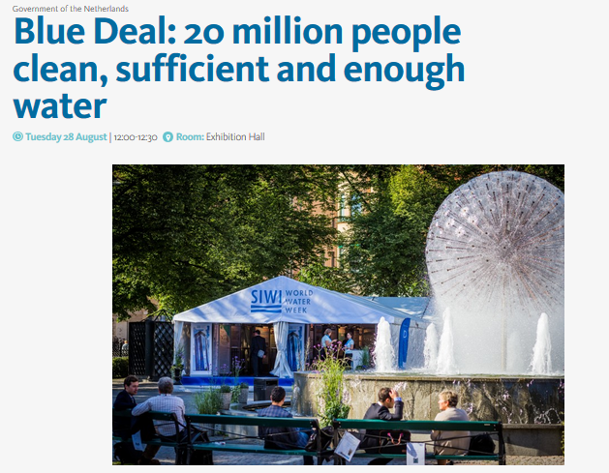
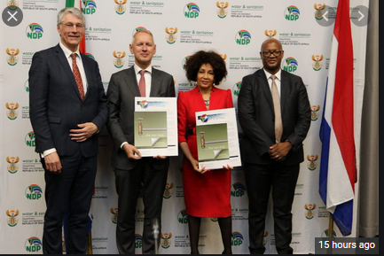
GLOBAL Blue Deal
Overview of Global Blue Deal
Learning Opportunities for South Africa

Slide 4
Blue Deal Partner Time Sheets
To capture “in-kind” time contributions of all South African Partners
This supports:
the “partnering principle” of Blue Deal
the funding of Blue Deal South Africa
Time sheets approach: Satisfactory & sufficient
Summary / Simple / Abbreviate template
Submission to date is spotty (not good enough)
Please submit to PMU via Eustathia by 20th of each month (for preceding month)
Designated champion from each Partner?

Slide 6
Blue Deal RAG Reports
Purpose:
Management Summary of Each Project for Sharing Across Partners
Supports and is necessary for Blue Deal global programme feedback by Netherlands PMT
Call for assistance where necessary
Captures and Conveys Monthly in a 1 to 2 page form
RAG status (red, amber, green)
Progress Headlines
Marketing Sound-Bites
Key Activities (month past & planned for coming month)
Risks and Any Partner oriented Requests for Assistance
Generated by Project Implementation Teams (RSA and Netherlands) & submitted by RSA project lead
Submit to PMU via Eustathia by 20th of each month

Slide 7
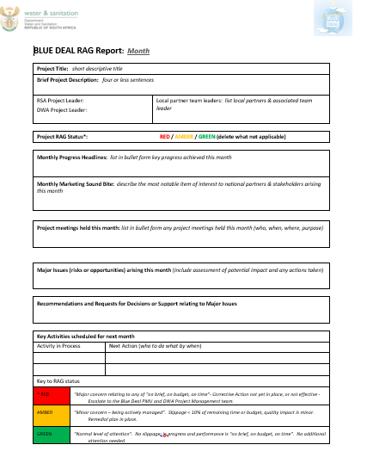

Slide 8
WISA 2020
Update on this weeks discussions
Embassy: Stephanie
DWS : Eusthathia
Next Steps

Slide 9
Mission Progress Review
Brief Summary
Next Steps
Requests for Partner Assistance

Slide 10
KEY ACTIVITIES: Phase One
Msunduzi River Improvement
Assisting in the development of a sustainable business model for the Enviro Champs.
Creating “an integrated Partner & Stakeholder” approach on water quality management and the associated multiple threats, via a “Living Catchment Management Strategy”.
Disaster Management partnership amongst both governmental organisations and industries, including annual drills.
Institutional and Infrastructure Improvements: Situational Diagnostics to include MuSSA/MPAP, Green Drop self-assessment, SFD, an external review of municipal sewer infrastructure, and assistance with municipal institutional weaknesses via Partners (DWA, DWS, MISA, CoGTA & SALGA)

Slide 11
Partners
Project partners Lead Partner: Department of Human Settlement, Water and Sanitation, KZN Office, (Mr Nkosinjani Mkhize), planning and coordination of all the different activities in this project, communication between local partners and the Dutch Water Authorities. Partner: Umgeni Environmental Infrastructure Partnership (UEIP), (Dr. Pearl Gola) occupied with the involvement of and the communication between the different partners and stakeholders. Partner: Msunduzi LM occupied with the responsibilities of Local Government (sewer system, WWTP, planning, solid waste, disaster management, et cetera) Partner: Dusi Umgeni Conservation Trust (DUCT), occupied with the activities around the Enviro Champs Umgeni Water: regional bulk water supply, depending on the Msunduzi –uMngeni river system, responsible for O&M of Darvill WWTP, expert on monitoring

Slide 12
Stakeholders
Catchment Management Forum Bring in the local expertise and communicate results of the Blue Deal project
uMgungundlovu District Municipality:
responsibilities of Local Government
Chamber of Commerce Address the local industries and commercial enterprises on their role and responsibility regarding the water quality, disaster management and environmental impact.
Academia (like University of KZN / Institute of Natural Resources / )
Natal Canoe Club: Organiser of the Duzi Marathon
Other Interested Parties:

Slide 13
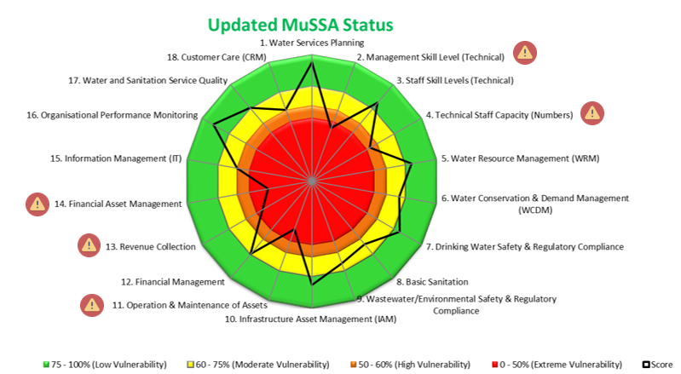
Institutional & Infrastructure
Msunduzi River Improvement
Situational Diagnostics : MuSSA/MPAP: 11th Feb 2020
External review of municipal sewer infrastructure: 26 Feb 2020

Slide 14
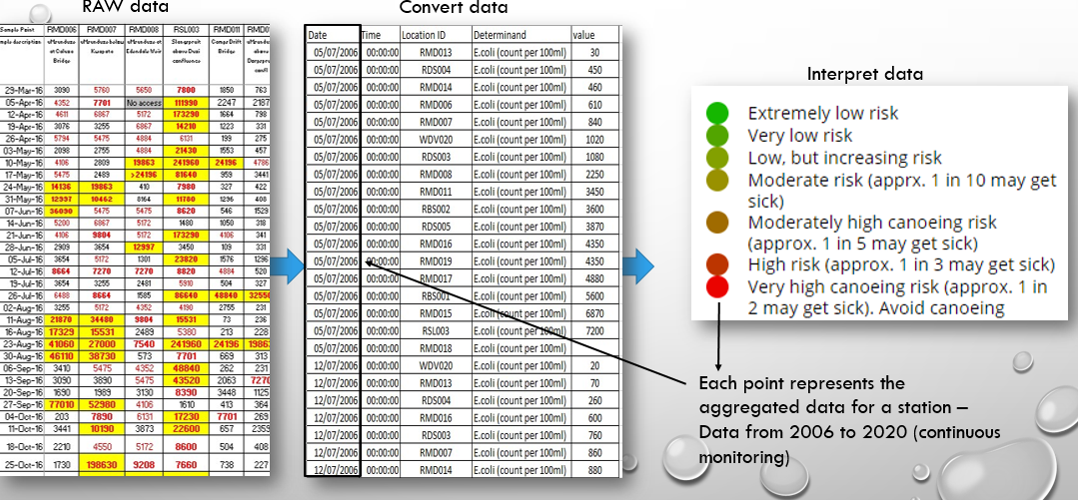
Partner & Stakeholder Integration: a Living CMS
Msunduzi River Improvement
Initial Focus on Data Sharing across all parties
DWS Data Bases; and Dusi Data from 2006 to 2020

Slide 15
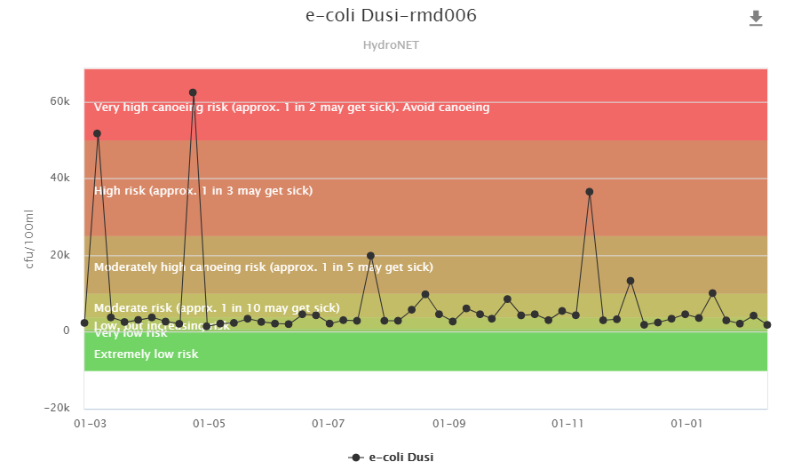
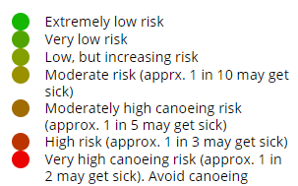
Viewing Data – The good
uMsunduzi at Caluza Bridge
LOW TO MODERATE OF GETTING SICK!
Notes:
Select point of interest
Graph will be loaded indicating water quality for that point
Trend analysis - Provides an indication of past and recent water quality – need continuous flow of data to keep graph updated
Legend on graph indicates if water is safe for recreation (i.e. canoeing)

Slide 16
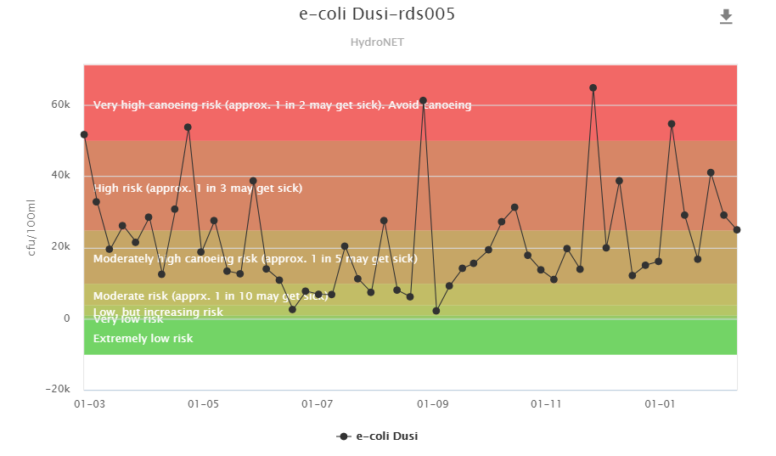
Viewing Data – The Bad
Dorpspruit Ohrtmann Road
MODERATE TO HIGH RISK OF GETTING SICK!
Notes:
Select point of interest
Graph will be loaded indicating water quality for that point
Trend analysis - Provides an indication of past and recent water quality – need continuous flow of data to keep graph updated
Legend on graph indicates if water is safe for recreation (i.e. canoeing)

Slide 17
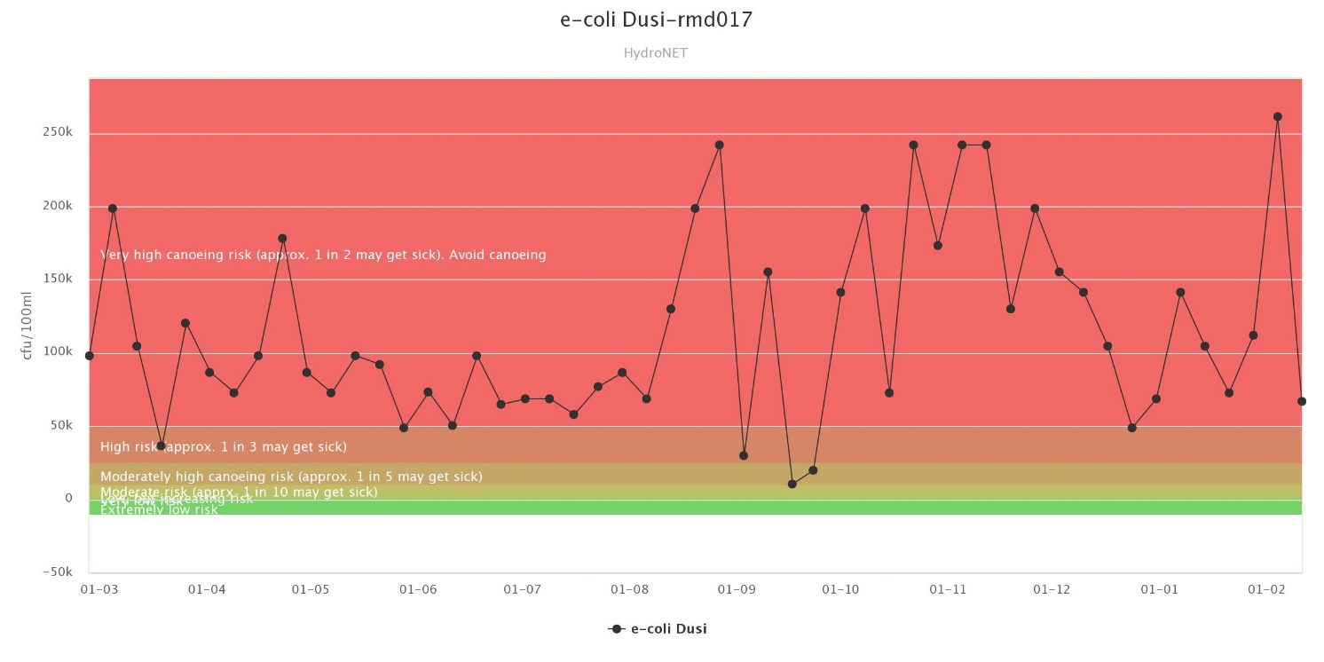
Viewing Data - The Ugly
uMsunduzi U/S Darvill mat river
DO NOT CANOE! VERY HIGH RISK OF GETTING SICK!
Notes:
Select point of interest
Graph will be loaded indicating water quality for that point
Trend analysis - Provides an indication of past and recent water quality – need continuous flow of data to keep graph updated
Legend on graph indicates if water is safe for recreation (i.e. canoeing)

Slide 18
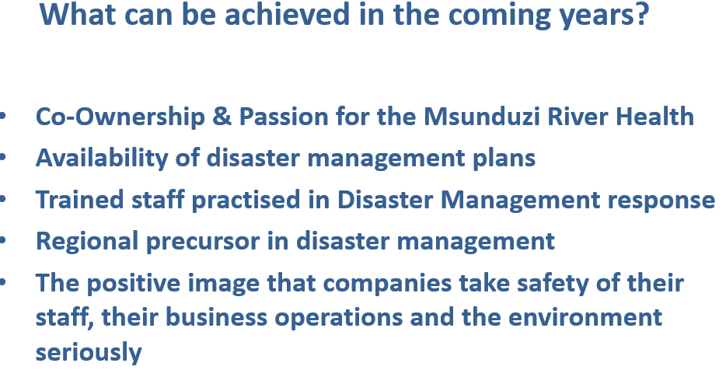
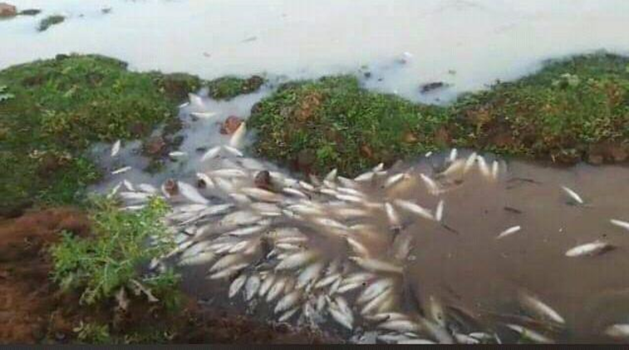
Disaster Management partnership: Govt & Industry
Msunduzi River Improvement
Introductory Meeting with Chamber of Business

Slide 19
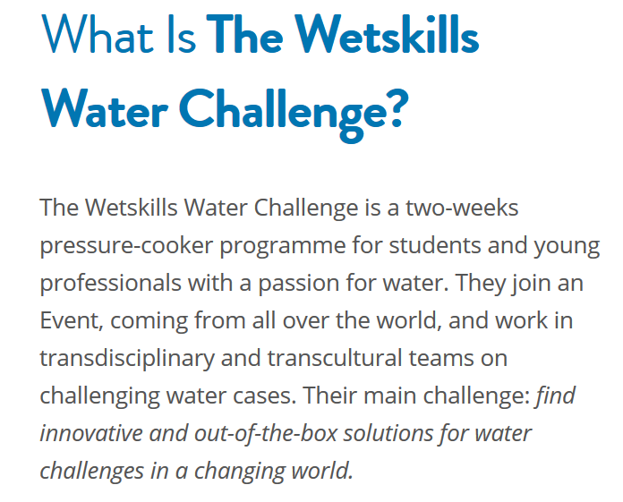
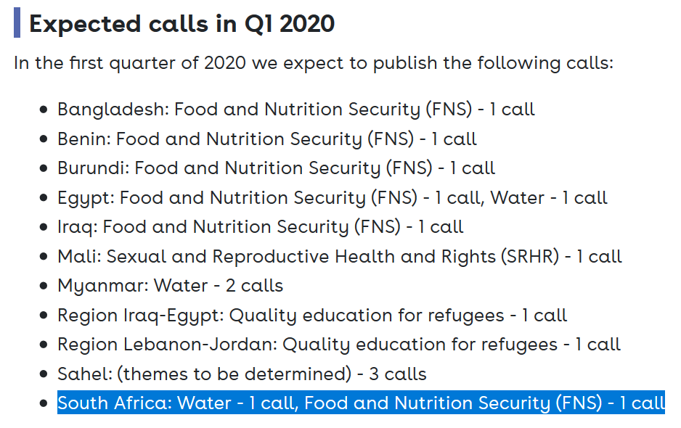
Sustainable Model with the Enviro Champs
Msunduzi River Improvement
Have looked for Netherlands Expertise : realisation that Blue Deal led team have inadequate understanding of Business Environment
Have identified some opportunities:

Slide 20
Additional Standard Discussion Item: national partners
Regarding the Blue Deal “Pillars of Success” (knowledge, institutional, relational) what does success look like for you by the end of Phase One (next 3.5 years) and by 2030?
What can you offer to success (immediate, short term, long term)
How can you be involved? Are you involved?

Slide 21
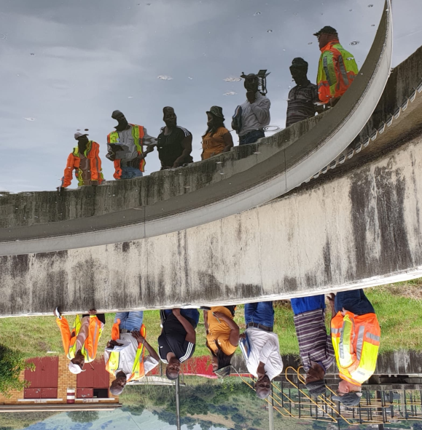
Crocodile River Improvement Project
Area:
Inkomati-Usuthu Water Management Area
Goal:
Improving the operation, maintenance and performance of 6 WWTW’s in:
Mbombela,
Nkomazi
Emakhazeni
Key Progress:
4 assessments carried out using WRC Guidelines
MISA assessments carried out
WRC Wader Skills Development using Virtual Reality and “first person gaming” initiated
Muni’s didnt make launch

Slide 22
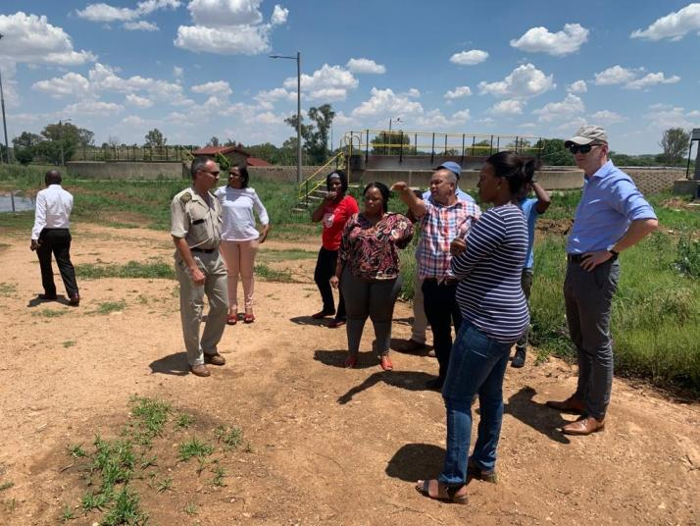
Vredefort Dome / Parys WWTW Project
Area:
Upper-Vaal Water Management Area
Goal:
Improving the water quality of the Vredefort Dome
Improving the operation, maintenance and performance of the Parys WWTW
Key Progress:
NL WWTW specialist on-site for 2 weeks
MISA inputs to WWTW require Mun Invitation
Muni’s didnt make launch

Slide 23
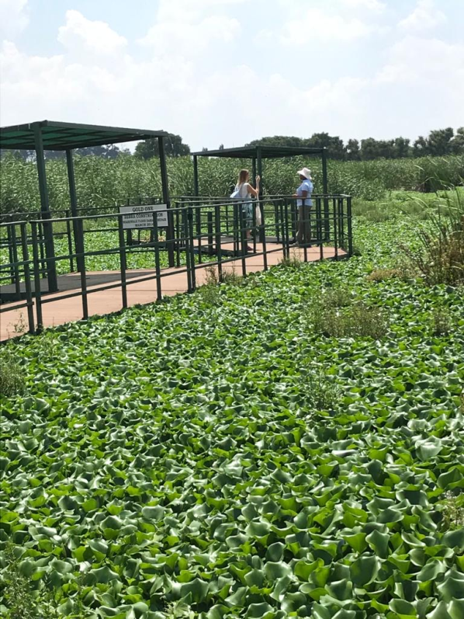
Blesbokspruit Project
Area:
Upper-Vaal Water Management Area
Goal:
Improving the water quality and water quantity of the Blesbokspruit
Managing the invasive reed and water hyacinth
Key Progress:
Very good partner engagement
Good progress on bio-controls
Good progress on spraying from DEFF
DEFF expertise very helpfull to GDARD and Ekurhuleni
Good progress with community incl upcoming training on insect nurturing
Young Expert Programme: Yvonne Dub
Muni’s didnt make launch

Slide 24
Blue Deal Phase One : National Partner Progress Meeting

Slide 25
BD Regional Launches: 8th March 2020
To take place in the week after WISA 2020, ie week beginning 8th June 2020
To be led and organised by the Local Implementation Team, including associated Blue Deal NL champions.
To involve and to be led by partner Mayor(s), Premier(s), provincial DWS Head, CoGTA Provincial Head, SALGA, WRC, PMU & PMT
To involve all local partners and stakeholders
To keep Blue Deal PMU / PMT communications team involved and informed

Slide 26
MINMEC and National Launch

Slide 27
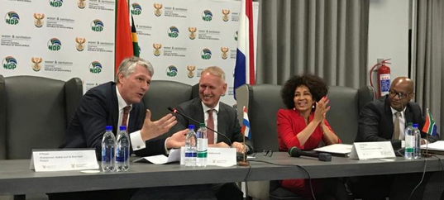
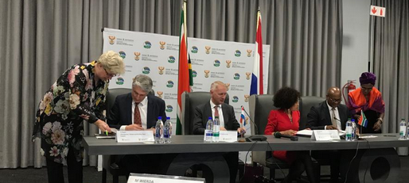
Blue Deal RSA National Launch

